Slide 1
INTRODUCTION OF FUNDAMENTAL RIGHTS

Slide 2
MEANING OF FUNDAMENTALS RIGHTS
Fundamentals rights are the basic human rights enshrined in the constitution of India which are guaranteed to all citizens . They are applied without discrimination on the basis of race , religion, gender,etc.

Slide 3
THERE ARE SIX FUNDAMENTALS RIGHTS
Right to equality (Article 14-18)
Right to freedom (Article 19-22)
Right against exploitation (Article 23-24)
Right to freedom of religion (Article 25-28)
Cultural and educational rights (Article 29-30)
Right to constitutional remedies (Article 32-35)

Slide 4

RIGHT TO EQUALITY (ARTICLE 14-18)
The right to equality for the equal treatment of everyone before the law, prevents discrimination on various grounds, treats everybody as equals in matters of public employment and abolishes untouchability and titles (such as Sir, Rai Bahadur, etc.)

Slide 5

RIGHT TO FREEDOM (ARTICLE 19-22)
The right to freedom gives citizens basic freedom with respect to speech and expression, from association, freedoms of personal liberty Freedom to live a life of dignity, etc.

Slide 6
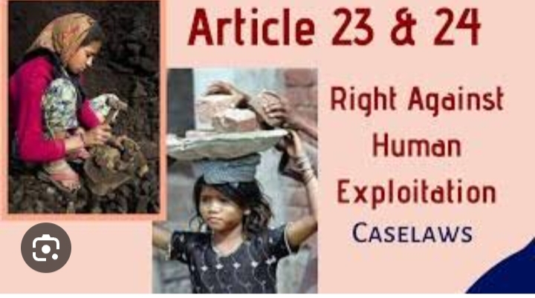
RIGHT AGAINST EXPLOITATION (ARTICLE 23-24)
The right against exploitation is a fundamental right guaranteed by the constitution of India.it includes the dignity and freedom of a person and prohibits all forms of forced labour, child labour, and human trafficking.

Slide 7

RIGHT TO FREEDOM OF RELIGION (ARTICLE 25-28)
The right to freedom of religion means that every individual has the right to practice and follow the religion of their choice.

Slide 8

CULTURAL AND EDUCATIONAL RIGHT(ARTICLE 29&30)
Cultural and educational rights are the rights of everyone to participate in the cultural life of their community, to enjoy the arts, and to receive an education.

Slide 9
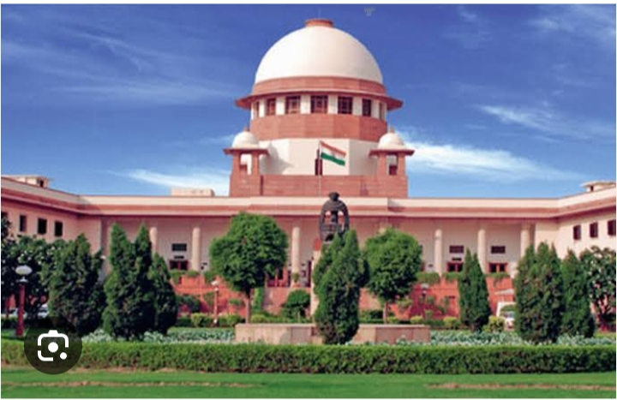
RIGHT TO CONSTITUTIONAL REMEDIES (ARTICLE 32)
Indian constitution guarantees every citizen the Right to constitutional Remedies, which includes equality before the law and equal protection of laws. This right is often exercised by filing a writ petition in the High Courts and supreme court of India.

Slide 10
Thanks for watching

